Slide 1

CSCI 5839 Fall 2014
Principles of
visual organization
Notes:
http://www.brooklynvegan.com/img/music2/cat_lasers_eyes.jpg

Slide 2

The circle of assignments
Pushed back some due dates
T4 now due Tuesday
All future assignments posted
Not much room to push things back further, so this is probably the final date

Slide 3
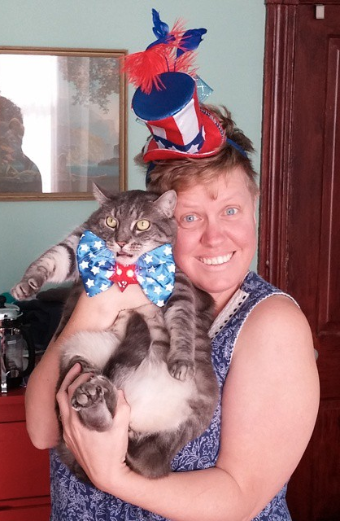
Also…
Don’t forget to vote!
You can still register today
Polling place at rec center
Notes:
Photo: Kate Drabinski

Slide 4
Inspirations (remember those?)

Slide 5
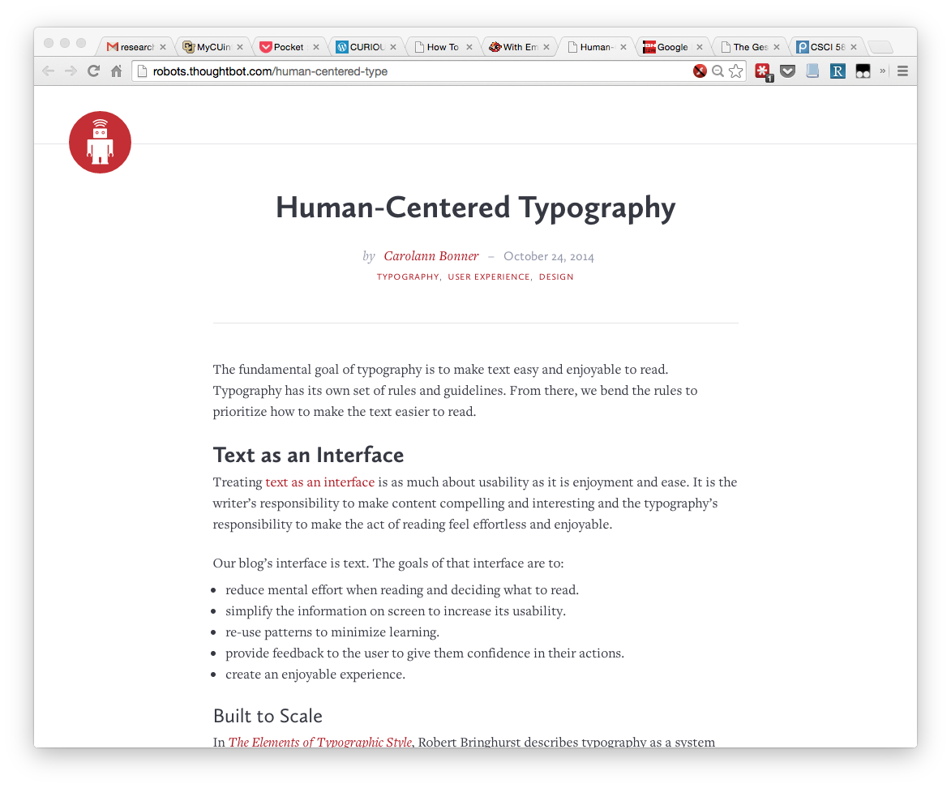
http://robots.thoughtbot.com/human-centered-type

Slide 6
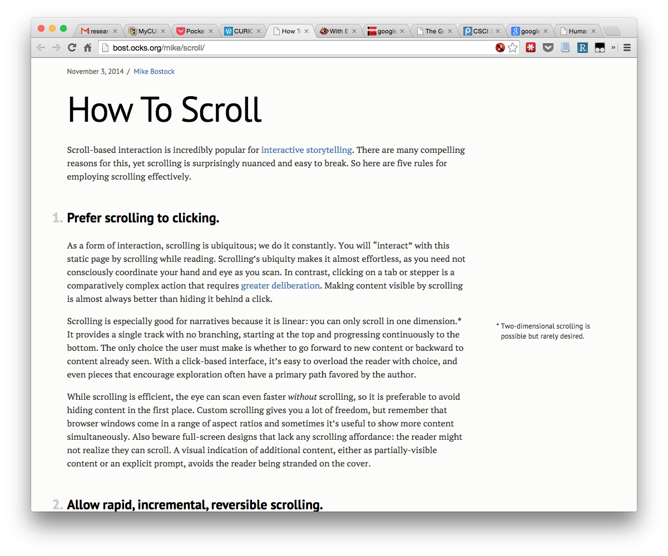
http://bost.ocks.org/mike/scroll/

Slide 7
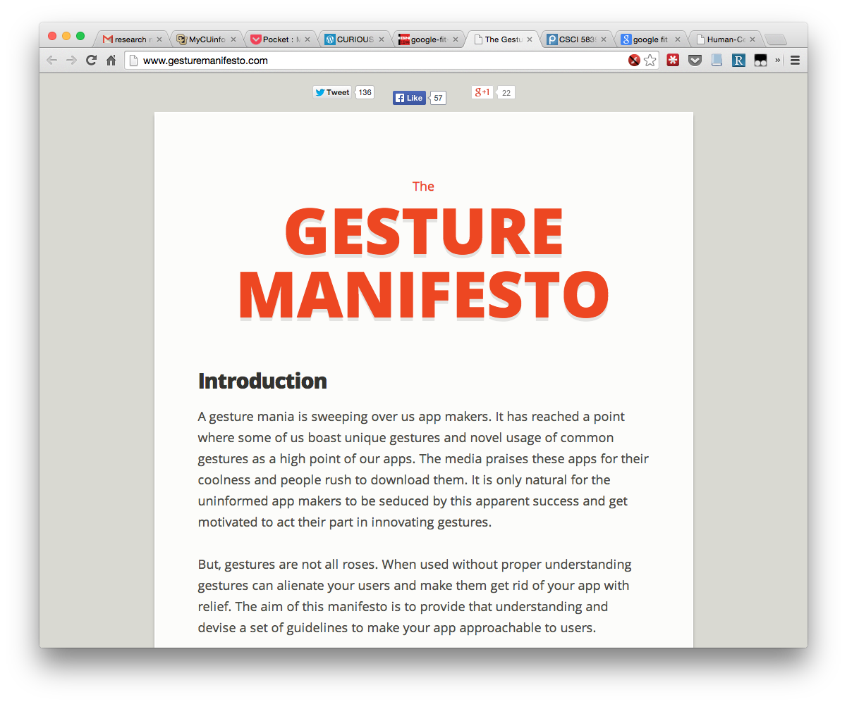
http://www.gesturemanifesto.com/

Slide 8
Today
Visual organization of user interfaces
Adapting visual design principles to user interface design

Slide 9
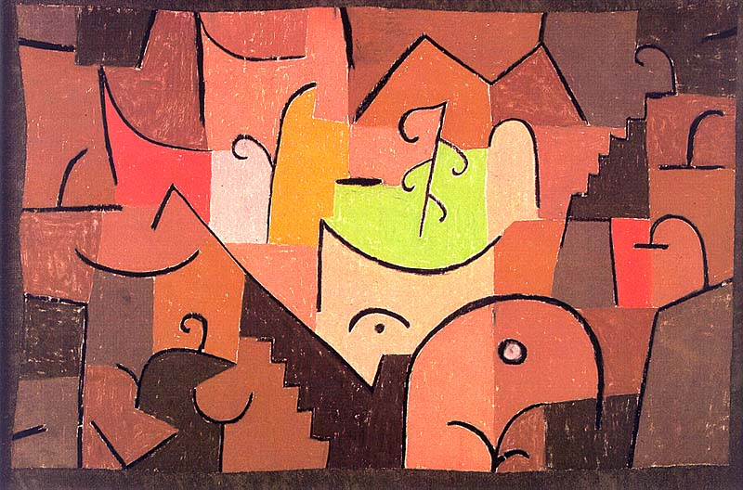
“The eye travels along the paths cut out for it in the work” – Paul Klee
“Design is mind control” – Fred Zinn
Notes:
Stage Landscape by Paul Klee
http://uploads3.wikiart.org/images/paul-klee/stage-landscape-1922(1).jpg

Slide 11
Why do we care about visual design?
Not just about aesthetics, but…
Visual design is key to interaction
We can use principles of visual design to help guide the user
Visual appearance can affect our perception of the app and our relationship to it
Visceral and reflective aspects of design

Slide 12
User interfaces vs. print documents
Dynamic layout
Reachability
Expecting interaction
Flexibility of use
Things change
Content can evolve
Task-driven
Fixed layout
No interaction
Similar use
Doesn’t change
Content fixed
Informative
Notes:
Reading order vs. interaction order
Meant to be read in one order
May be accessted in different orders
May change

Slide 13
Goals for visually designing UIs
Skimmable
Figure out what’s possible
“Don’t make me think”, make it obvious
Save time / efficiency
Nice to look at
Not cluttered
Aesthetically pleasing
Notes:
Make it clear what to do
Make it clear what’s important
Make changes and effects clear (feedback)

Slide 14
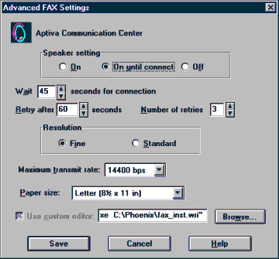
Consequences of UIs with bad visual design
What can I do?
In what order do I do things?
What’s important?
What just happened?
I can’t find what I’m looking for :(
Notes:
http://interfacehallofshame.eu/www.iarchitect.com/visual.htm

Slide 15
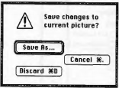
False structure
“Obviously those things are related (or unrelated)”

Slide 16
Elements of visual design
Layout / organization
Color
Type
Symbols / icons / images
Creating conventions
Navigation (scrolling, paging, etc.)

Slide 17
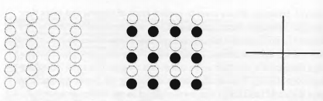
Principles of visual organization (Mullet/Sano)
Gestalt (“whole”) processing
Proximity / spacing
Similarity / contrast
Continuity / discontinuity

Slide 18
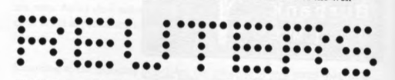
Tools for visual organization (Mullet/Sano)
Design principles
Grouping
Hierarchy
Relationship (alignment, position, size)
Balance

Slide 19
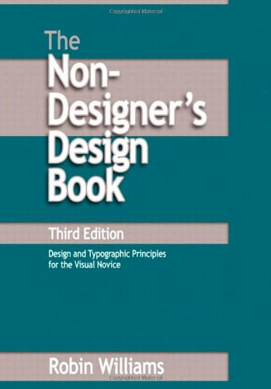
Another perspective
The elements of design are:
Contrast
Repetition
Alignment
Proximity … (“CARP”)

Slide 20
Practical considerations
Don’t be afraid of contrast
Don’t be afraid of white space
Remember reading order
Remember conventions

Slide 21
Contrast
Things that are the same: present them as the same
Things that are different: make them really different

Slide 22
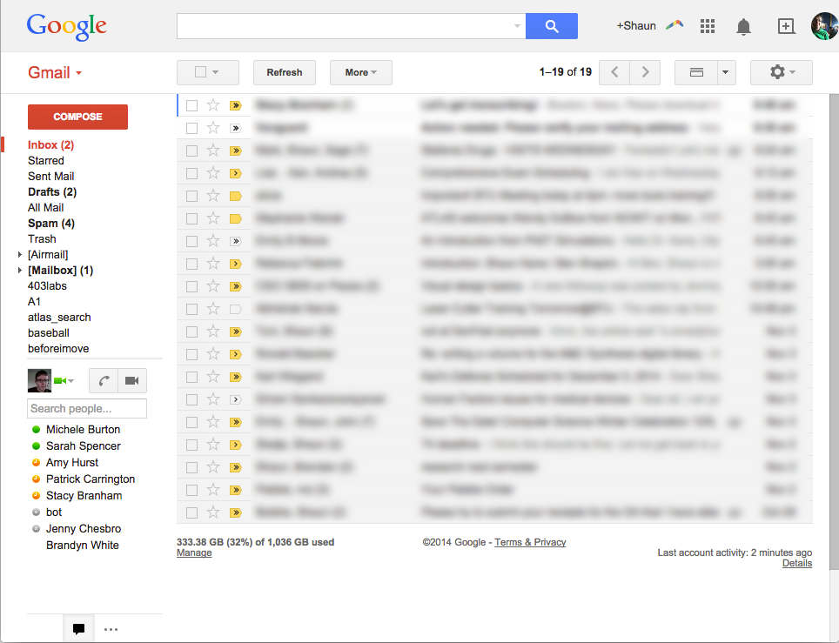

Slide 23
Don’t be afraid of white space
Early designer’s instinct is to put everything inside a box
White space can achieve the same effect, but with less visual clutter
But don’t lose important details

Slide 24
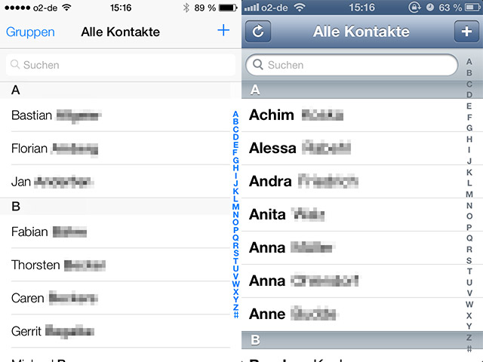
Notes:
Ios 6-7

Slide 25

Notes:
http://www.reddit.com/r/CrappyDesign/comments/2ggcea/dont_season_miss_the_finale/

Slide 26
Remember reading order
“F” shape (at least in English)
http://www.nngroup.com/articles/f-shaped-pattern-reading-web-content/

Slide 27
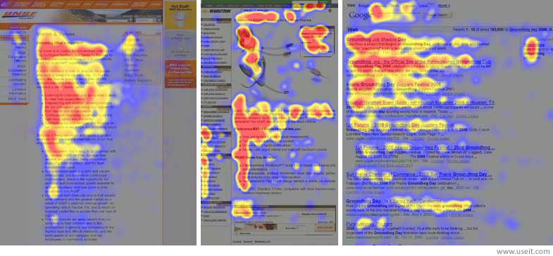

Slide 28
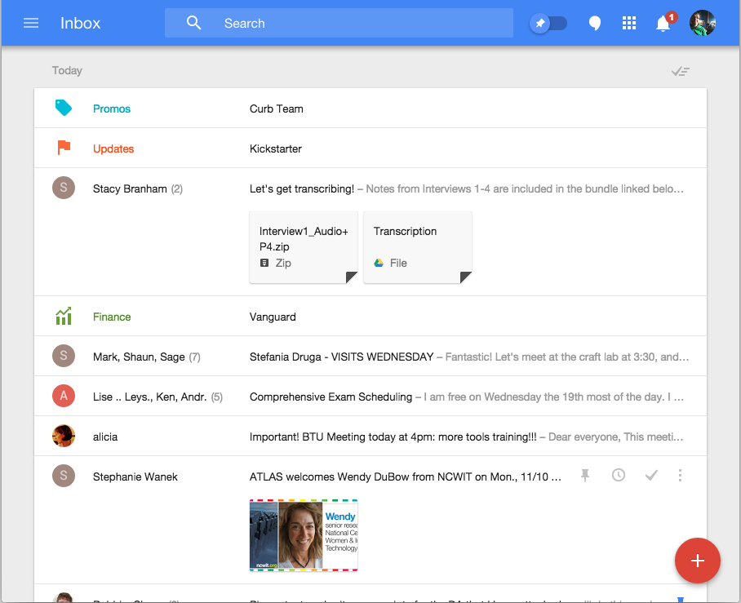

Slide 29
Remember layout conventions
Where do users typically find the menu, help, search, settings
Note that this may vary by platform
Steve Krug’s “trunk test” – you were kidnapped by a gang, thrown in the trunk of a car, escape and load up a web page. How quickly can you identify what’s going on?

Slide 30
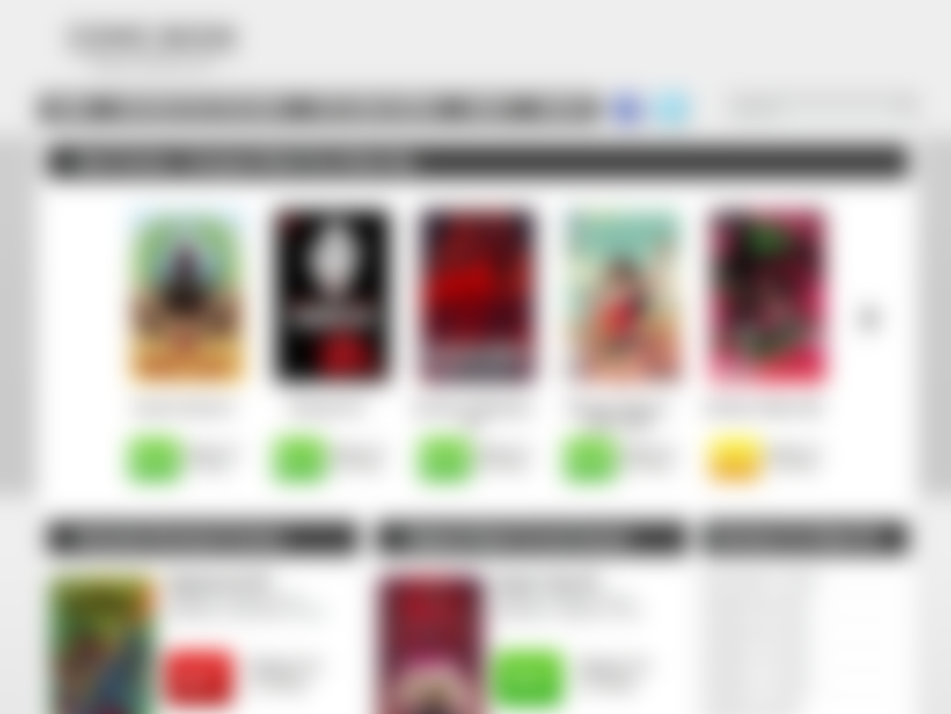
Notes:
Where’s the hierarchy?

Slide 31
Examples of bad design
http://baduiuxdesign.tumblr.com/
http://sloppyui.tumblr.com/
http://www.reddit.com/r/CrappyDesign
http://interfacehallofshame.eu/
http://blog.userfocus.co.uk/

Slide 32
Activity
Partner up with someone
Pick a specific screen of an app or web site
Critique it with respect to: grouping, hierarchy, relationship, balance
And sketch out how to fix it

Slide 33
Next time
Mid-fidelity prototyping with Axure
Bring a device that can run Axure (coordinate with your group)
Make sure Axure is installed (free demo or free educational license)
Next Tuesday: more about design, type, color, and grids

